Slide 1
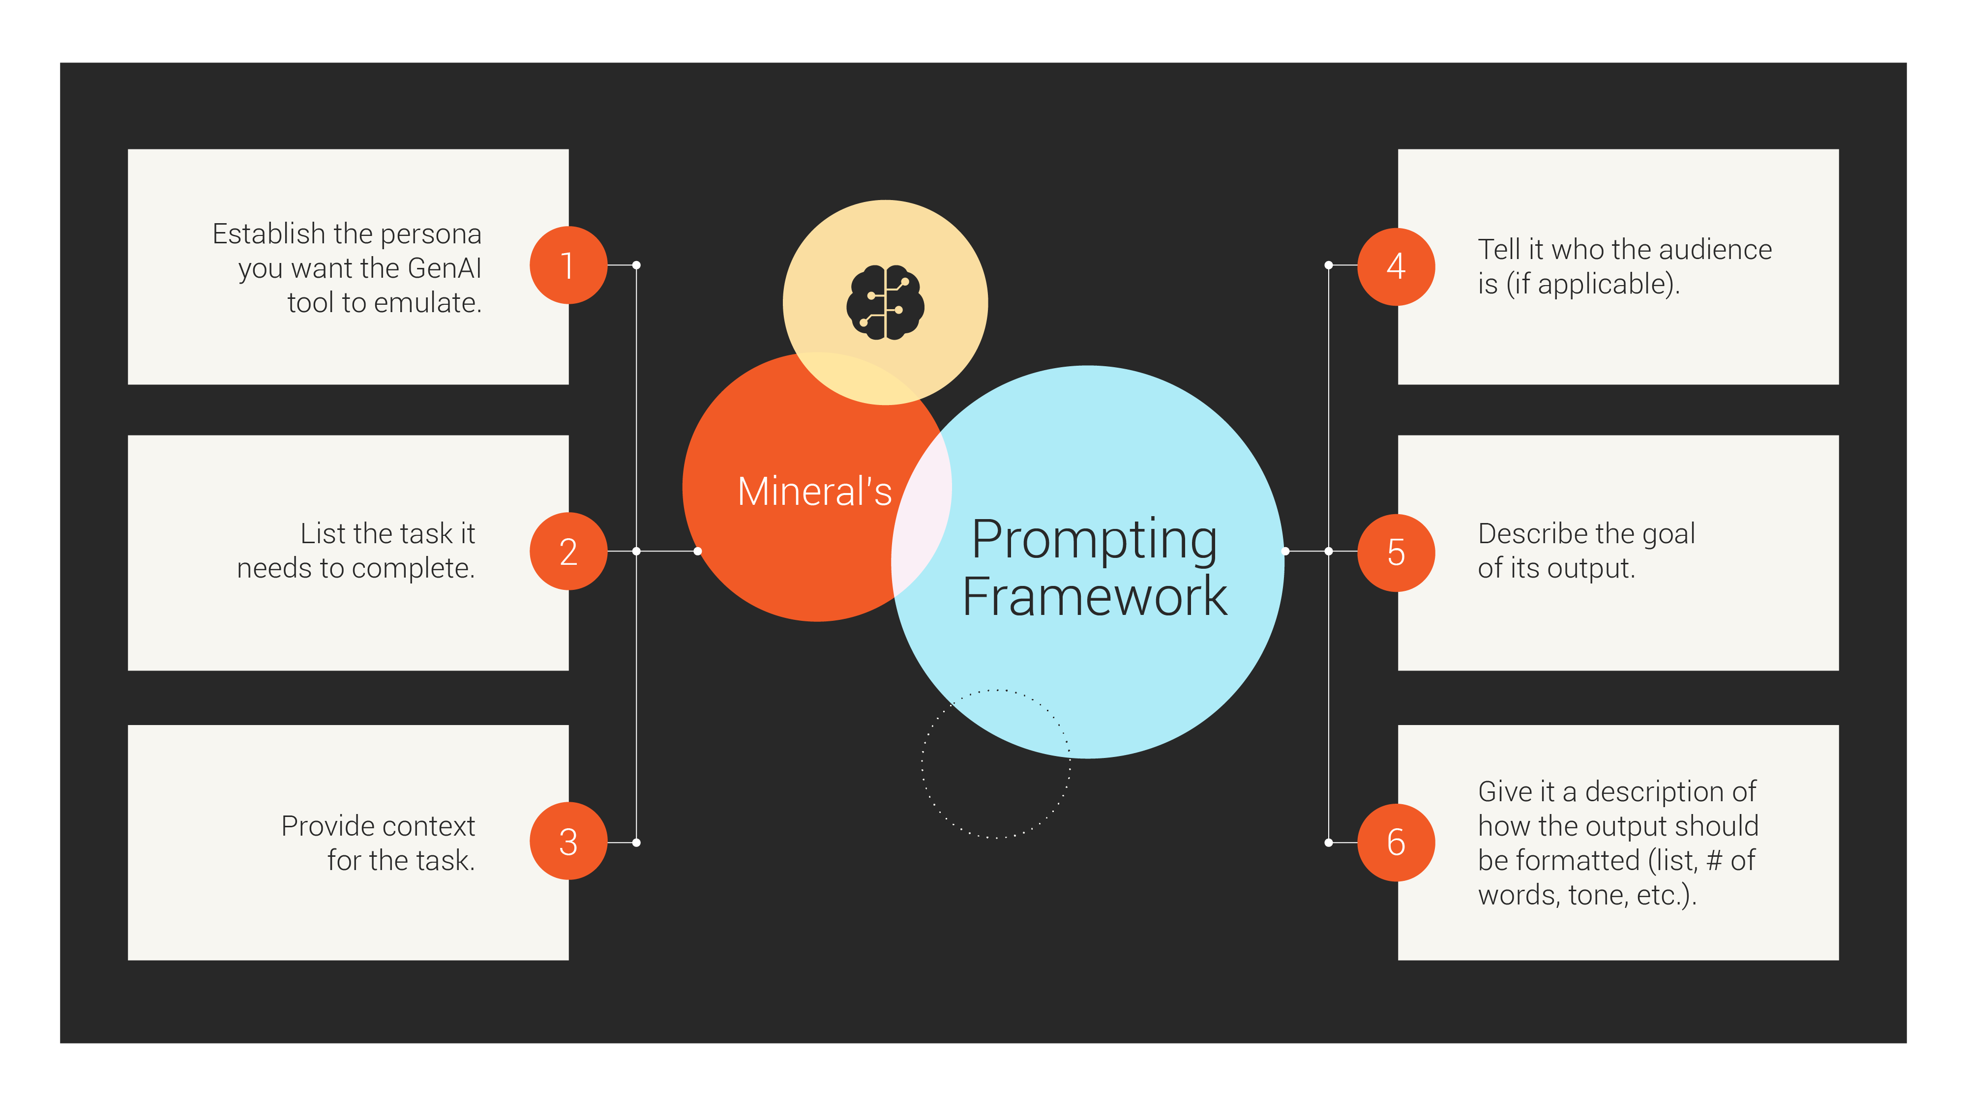

Slide 2
Questions for consideration: Does your GenAI tool have a name? A gender? A personality? A voice?
[Space to take notes]
[Space to take notes]

Slide 3
Questions for consideration: Does your Gen AI tool need to solely answer the prompt it’s given, or also anticipate user follow-ups? Clarity in this step helps guide prompts needed for learning and training.
[Space to take notes]
[Space to take notes]

Slide 4
Question for consideration: What institutional, historical, or social information does a human have than an AI would need to give accurate responses?
[Space to take notes]
[Space to take notes]

Slide 5
Question for consideration: What cultural, social, educational, geographical, and demographic information will AI need to create a connection with a user so its responses will be trusted?
[Space to take notes]
[Space to take notes]

Slide 6
Questions for consideration: What is the call to action? What should a user ideally think, know, and do after receiving an AI-generated response?
[Space to take notes]
[Space to take notes]

Slide 7
Question for consideration: Should generated responses be conversational or directive? The answer will inform how to format AI output.
[Space to take notes]
[Space to take notes]

