Slide 1
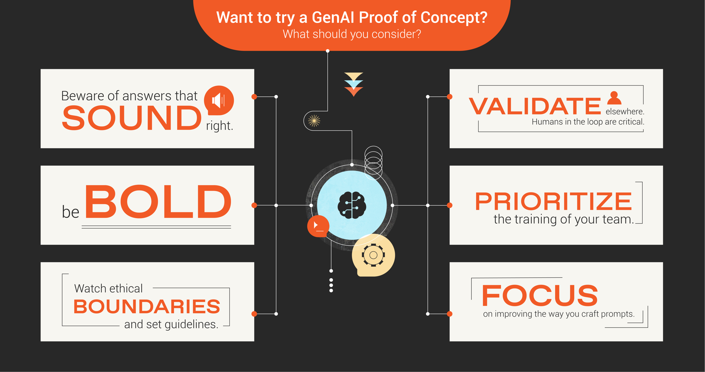

Slide 2

Generative AI is powerful … but also fallible. Build a strong backstop for how to “fact check” its responses to ensure accuracy for your organization and its customers.
[Space to take notes]
[Space to take notes]

Slide 3

Now is the time to think big! Don’t simply go outside the box—create a new one altogether. Consider the ideal functionality and outcomes and work backward to make it reality.
[Space to take notes]
[Space to take notes]

Slide 4

Even though powered by humans, AI tools lack human traits like empathy and ethics. Consider how to set AI-specific guidelines and guardrails for generating ethical and empathetic responses.
[Space to take notes]
[Space to take notes]

Slide 5

Who—will serve as the human “source of truth” for generative AI? And where will that person/people sit in the process to ensure validity and credibility? Questions that need answering at the outset.
[Space to take notes]
[Space to take notes]

Slide 6
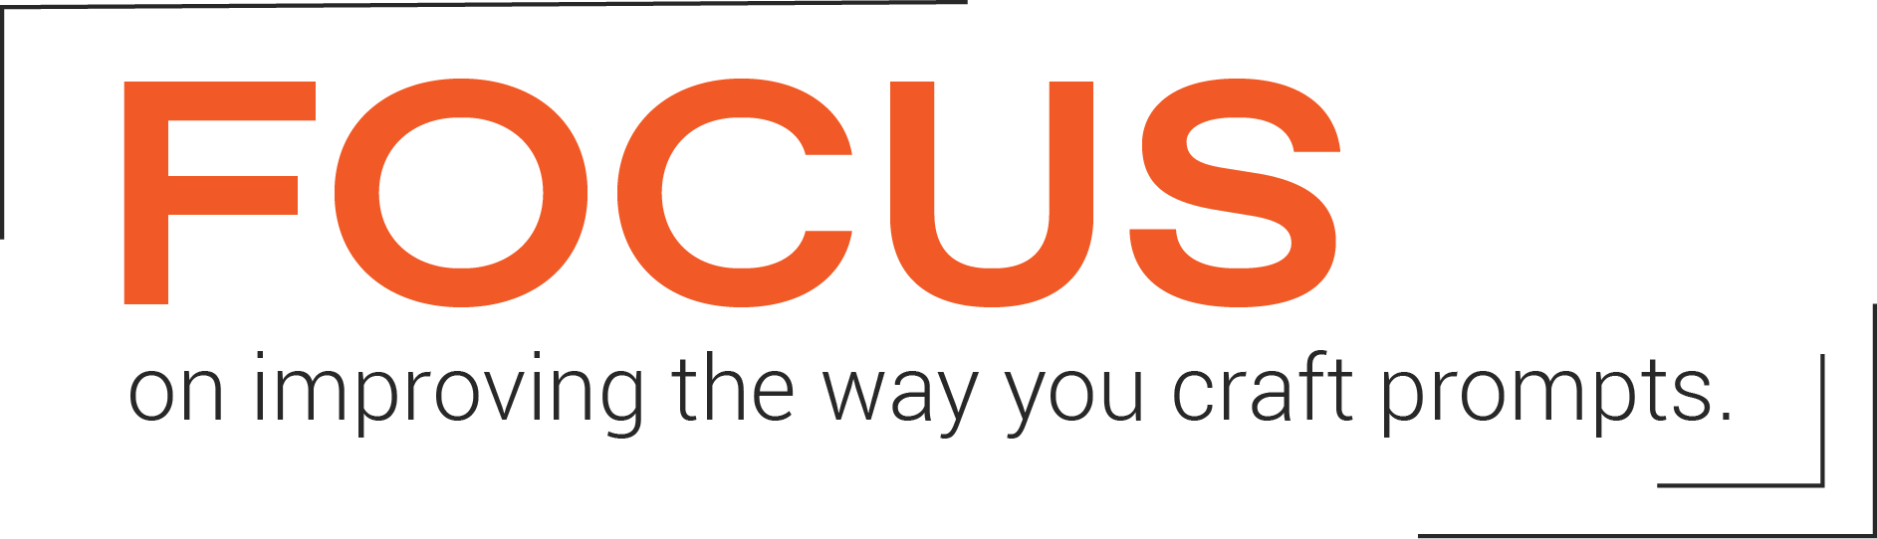
When it comes to prompt crafting for AI, what you say and how you say it are of equal importance. Consider what resources and/or templates you’ll use to ensure strong prompts.
[Space to take notes]
[Space to take notes]

Slide 7

Generative AI can only be trained as well as the human team that trains it. How will you upskill/reskill your team to help AI learn and produce quality responses?
[Space to take notes]
[Space to take notes]

